Slide 1
California Vaccination Progress
By: Alfonso Perez & Carlos Sanchez

Slide 2
Data Used
COVID-19 Vaccine Progress Dashboard Data For California
COVID-19 Vaccination By Demographic
COVID-19 Vaccination By County

Slide 3
Azure Machine Learning
Focused on training Two types of data/columns
Cumulative Fully Vaccinated
Cumulative Total Doses

Slide 4
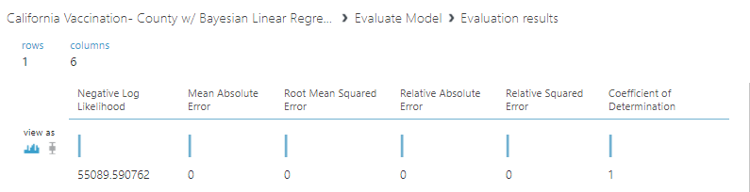
Evaluating County Dataset Error w/ Bayesian Linear Regression
Train Model: Cumulative Total Doses

Slide 5
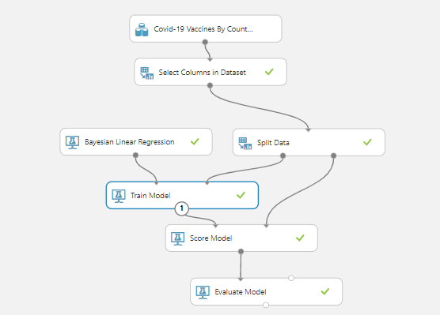
County Dataset Model w/ Bayesian Linear Regression

Slide 6
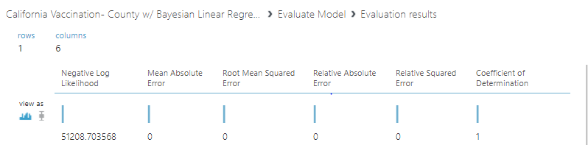
Evaluating County Dataset Error w/ Bayesian Linear Regression
Train Model: Cumulative Fully Vaccinated

Slide 7
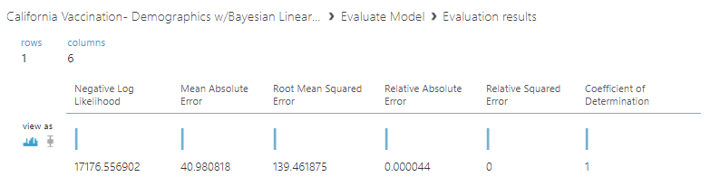
Evaluating Demographics Dataset Error w/ Bayesian Linear Regression
Train Model: Cumulative Fully Vaccinated

Slide 8
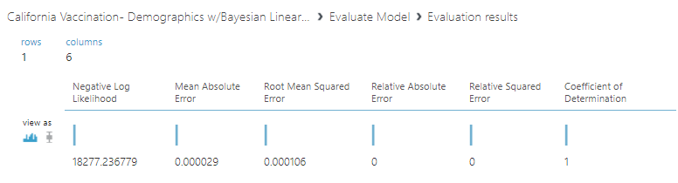
Evaluating Demographics Dataset Error w/ Bayesian Linear Regression
Train Model: Cumulative Total Doses

Slide 9
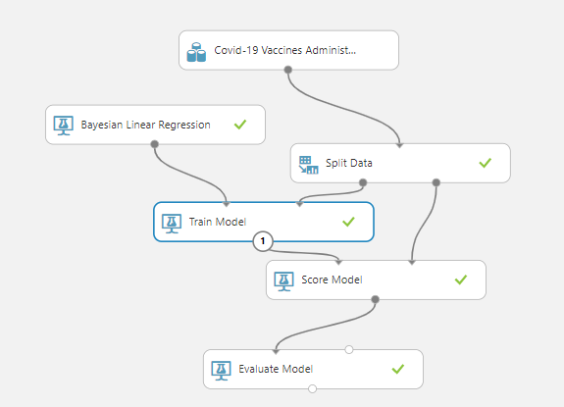
Demographics Dataset Model w/ Bayesian Linear Regression

Slide 10
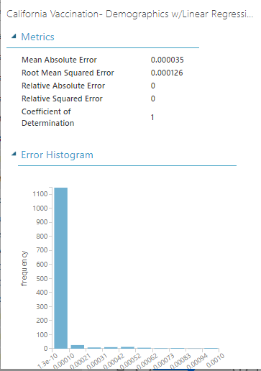
Evaluating Demographics Dataset Error w/Linear Regression
Train Model: Cumulative Total Doses

Slide 11
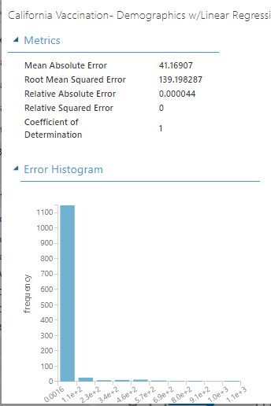
Evaluating Demographics Dataset Error w/Linear Regression
Train Model: Cumulative Fully Vaccinated

Slide 12
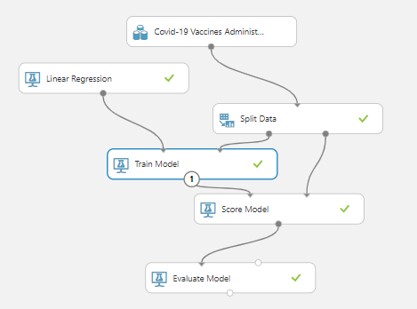
Demographics Dataset Model w/ Linear Regression

Slide 13
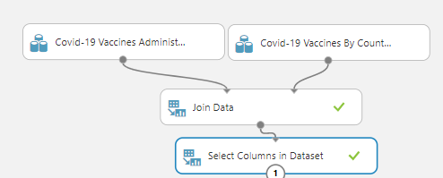
Joining The Two Datasets

Slide 14
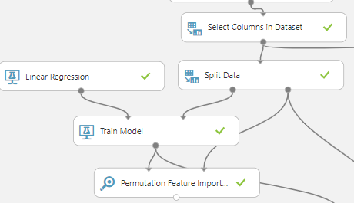
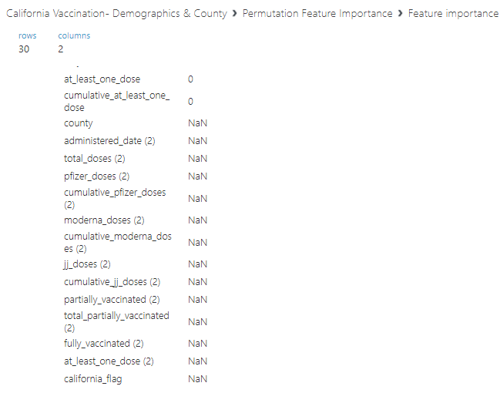
Permutation Feature Importance Model

Slide 15
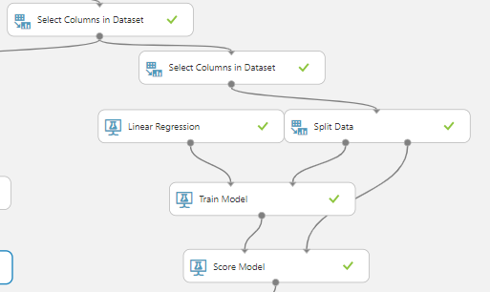
Made A Separate Training Model

Slide 16
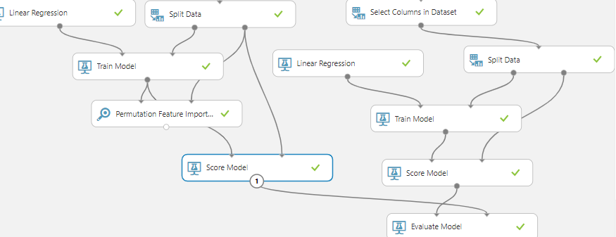
Added Score Model And Evaluated

Slide 17
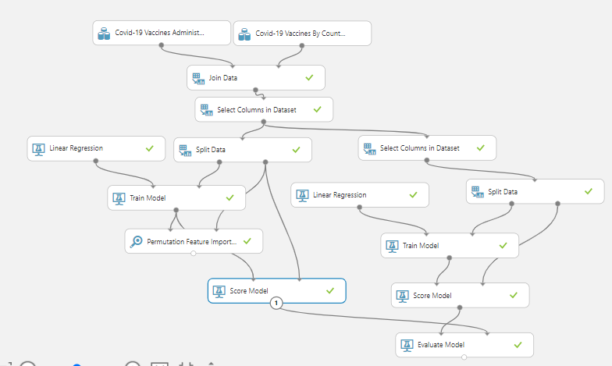
Final Model

Slide 18
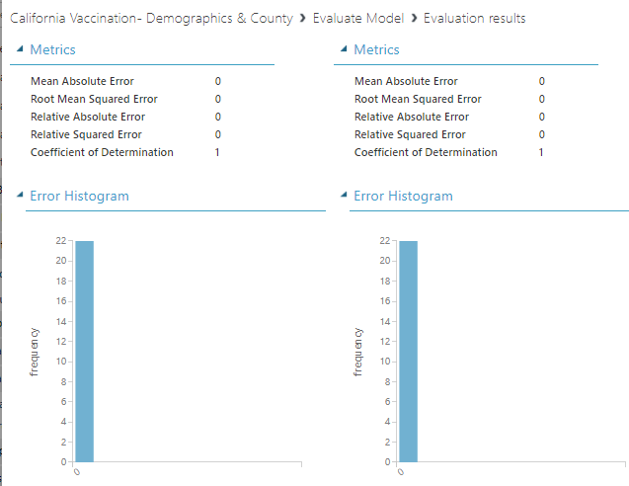
Model Results Comparison For Cumulative Fully Vaccinated

Slide 19
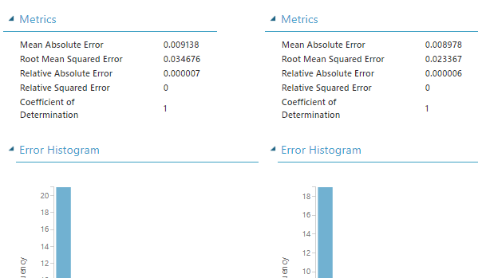
Model Results
Cumulative Total Doses(w/No NAN)|Cumulative Total Doses(w/NAN)

Slide 20
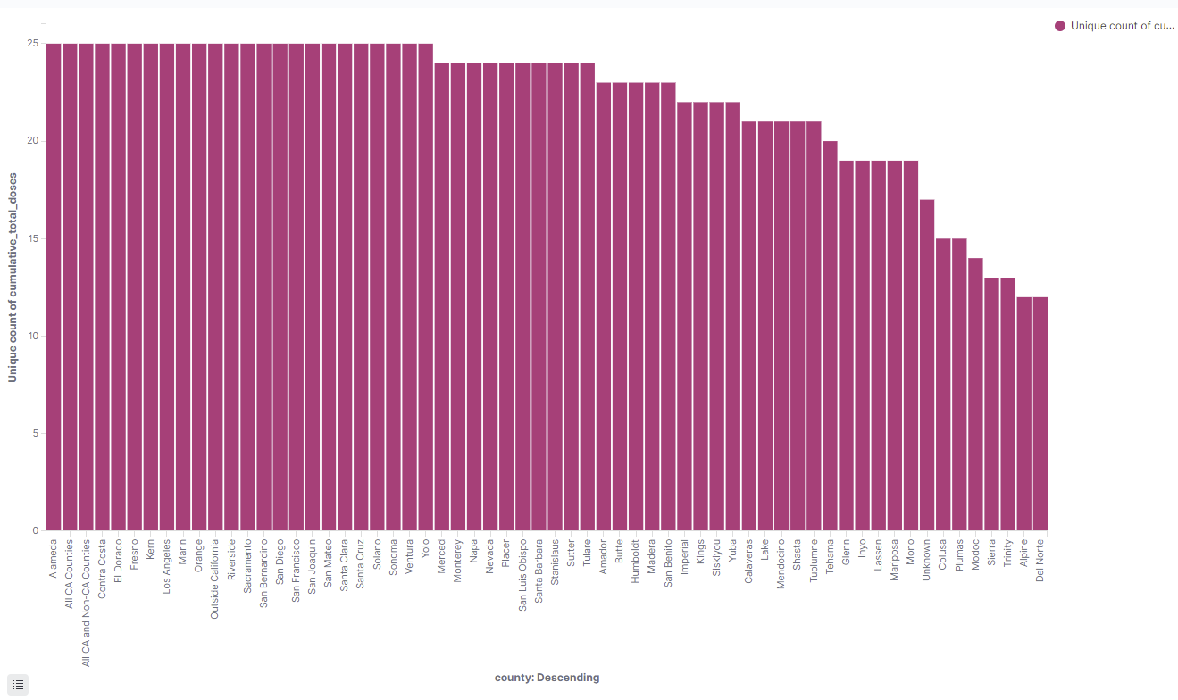
Visualizing Data

Slide 21
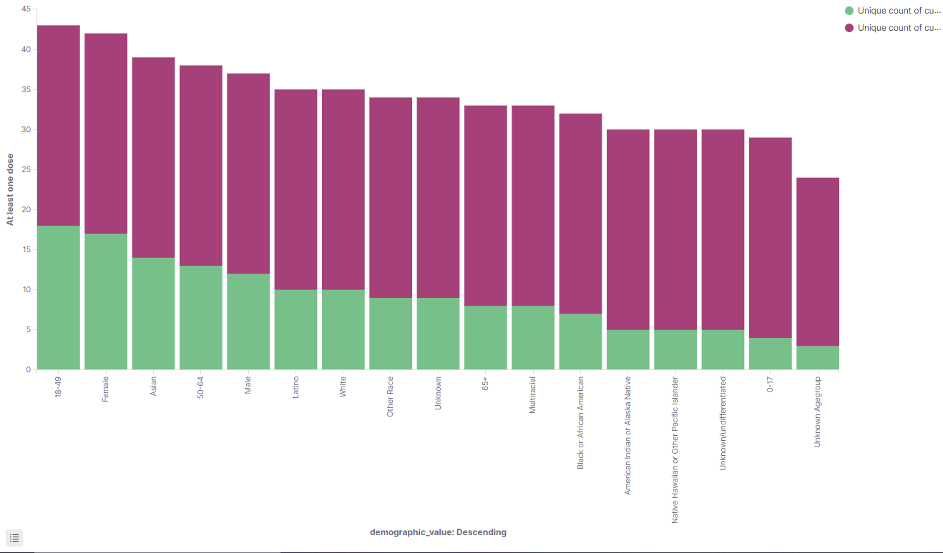
Visualizing Data

Slide 22
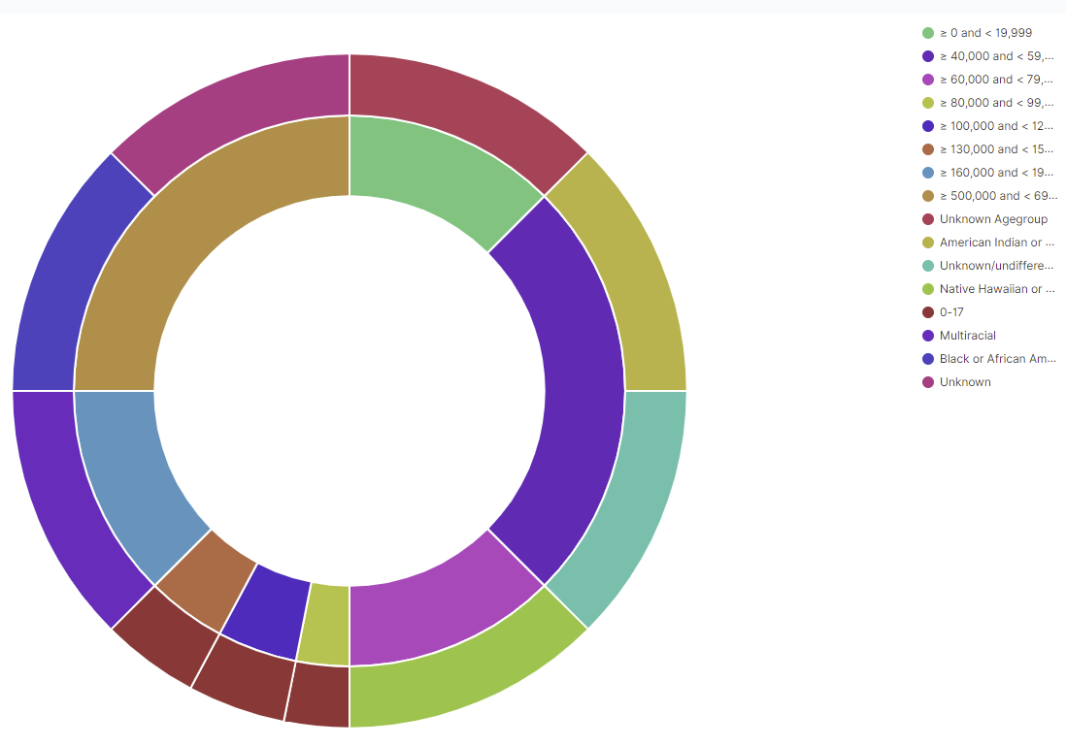
Visualizing Data

Slide 23
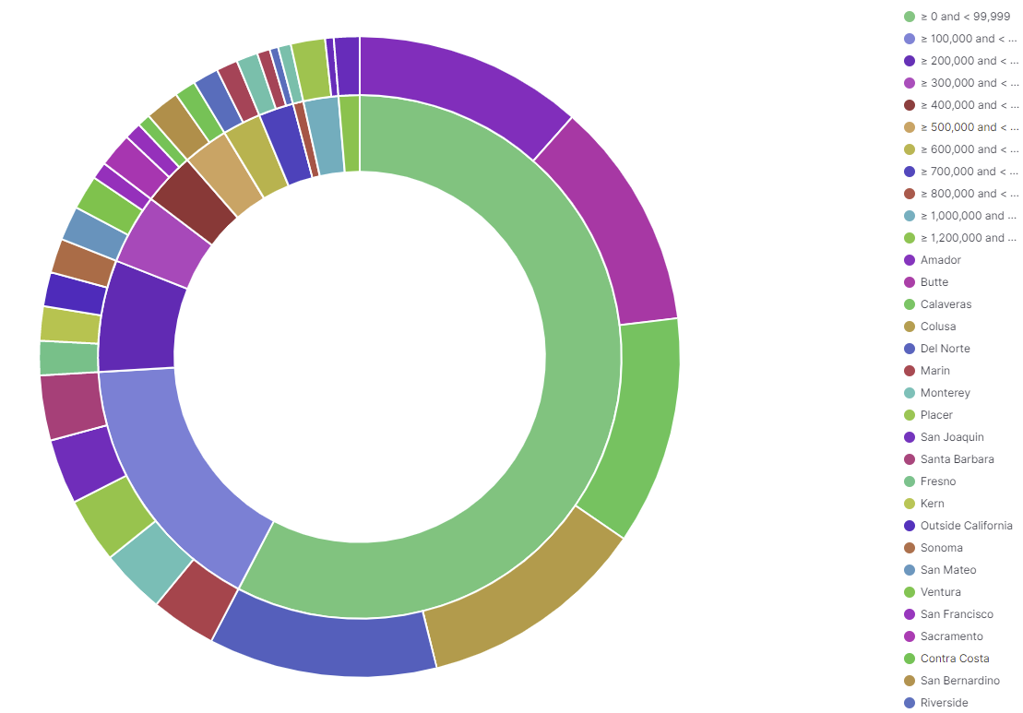
Visualizing Data

Slide 24
References:
LINK FOR AZURE ML: https://studio.azureml.net/Home/ViewWorkspaceCached/e839ba1d4cd4455e9af1e8610742b5e4?#Workspace/Experiments/ListExperiments
Data Source: https://data.chhs.ca.gov/dataset/vaccine-progress-dashboard
Elastic Link:https://4f3b2b9038c04b85a6a137abfde9b509.us-central1.gcp.cloud.es.io:9243/app/dashboards#/view/7f31cf40-b2a9-11eb-9680-e7ae60df816f?_g=(filters:!(),refreshInterval:(pause:!f,value:30000),time:(from:'2021-05-01T07:00:00.000Z',to:'2021-05-09T06:30:00.000Z'))&_a=(description:'',filters:!(),fullScreenMode:!f,options:(hidePanelTitles:!f,useMargins:!t),query:(language:kuery,query:''),timeRestore:!f,title:'Vaccinations%20in%20California',viewMode:view)
Data Source URL: https://data.chhs.ca.gov/dataset/vaccine-progress-dashboard

